Slide 1
Content Management system for Kilgore College library
Requirements
Comparison
Model Selection
Demo

Slide 2
Requirements
Security – Prevent anonymous user to visit
Easy to use - Users don’t need the knowledge of web building
Maintenance – Easy
Budget - Open source, totally free
Interface – Friendly
Abundant Function - Content management system
WYSWYG - What you see is what you get

Slide 3
Comparison
phpBB (Interface bad)
Druple (Hard to use, maintenance is troublesome)
WordPress (Ugly and Hard to use)
MediaWiki (Wonderful)

Slide 4
Model Selection
Media Wiki - Tools is tools.
Princeton (https://qed.princeton.edu/main/Main_Page)
Harvard (https://wiki.med.harvard.edu/)
Standord (http://web.stanford.edu/wiki)
U Michigan (http://webservices.itcs.umich.edu/mediawiki/oaibp/index.php/Main_Page)
Columbia U (http://www.wikischolars.columbia.edu/)
Cornell U (http://www.cuwiki.org/)
U CalGary (http://wiki.ucalgary.ca/page/Main_Page)
WorldCat (http://www.worldcat.org/title/on-beauty-a-novel/oclc/61396956?tab=reviews)
U South California Aika (http://library.usca.edu/Main/HomePage)
Students use it inappropriately, does not mean it cannot be a good tools in content management, if the person who create and use it have a very serious attitude .

Slide 5
Demo
Login
Create a web link
Create a PDF link
Create a picture file display
Submit Microsoft office documents
How to delete a resource
Create a new page
How to delete a page

Slide 6
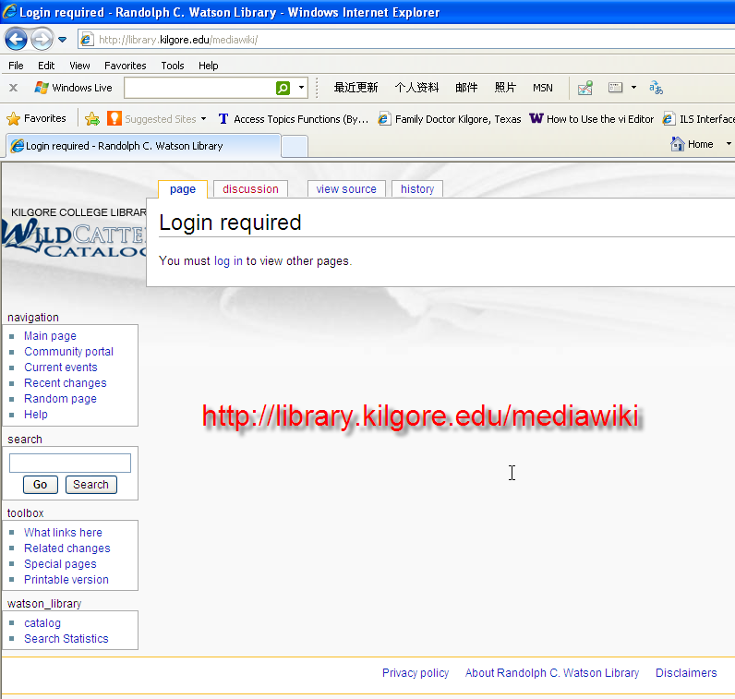
Demo – Login 1

Slide 7
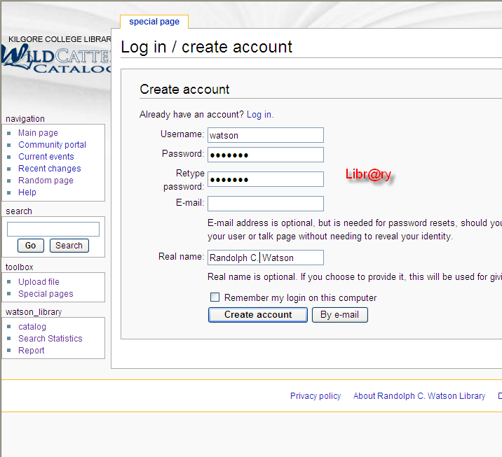
Demo – Login 2

Slide 8
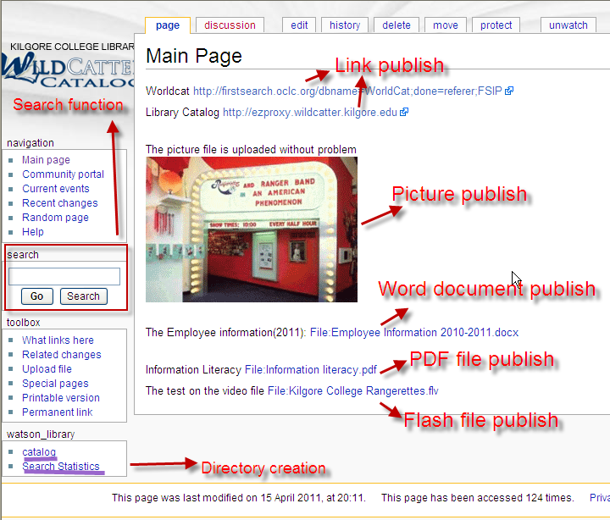
Demo – Main page intro

Slide 9
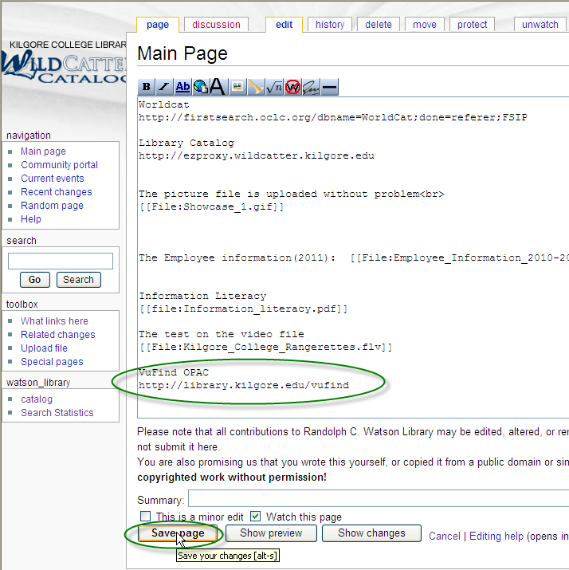
Demo – Create a new web link 1

Slide 10
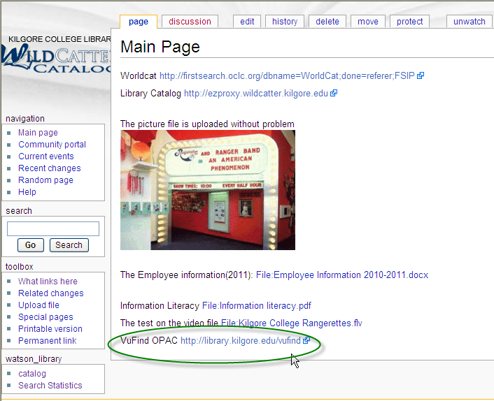
Demo – Create a new web link 2

Slide 11
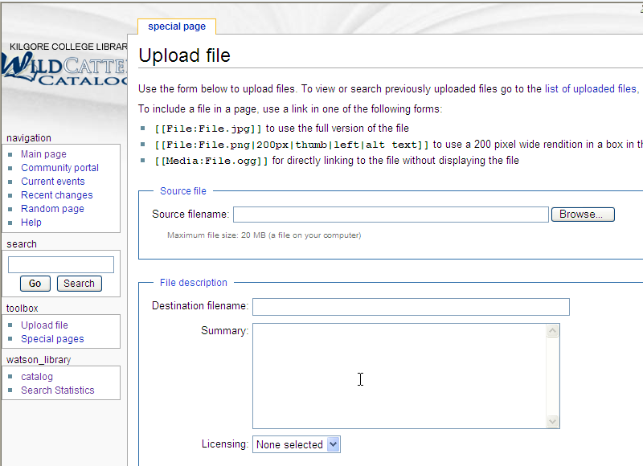
Demo – Create a new PDF link 1

Slide 12
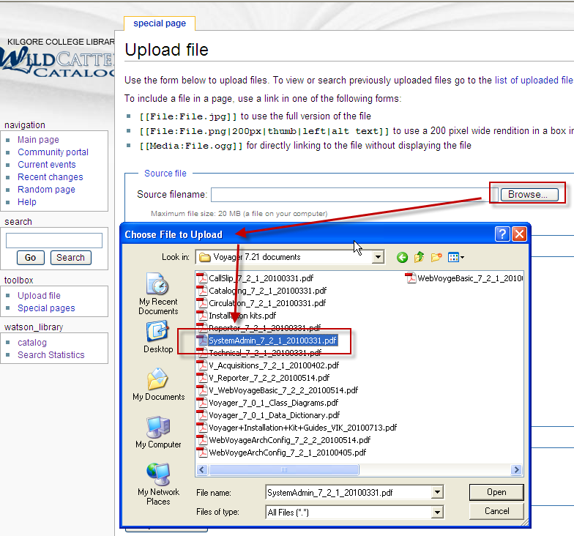
Demo – Create a new PDF link 2

Slide 13
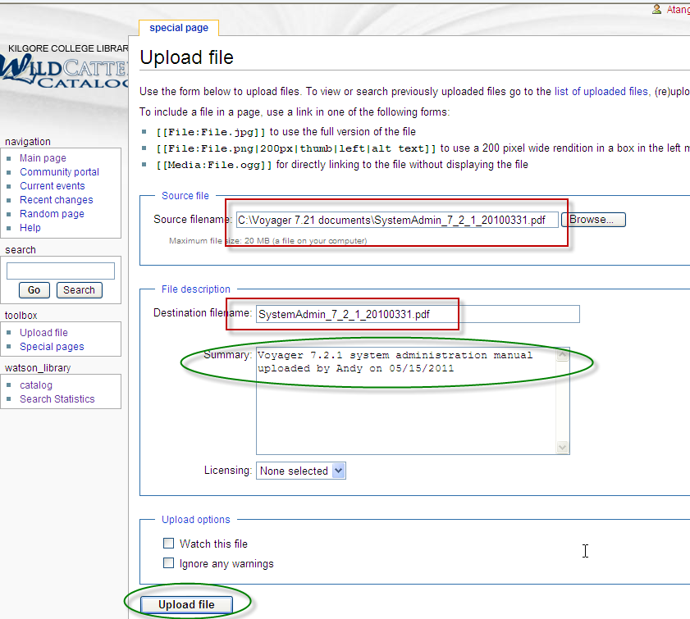
Demo – Create a new PDF link 3

Slide 14
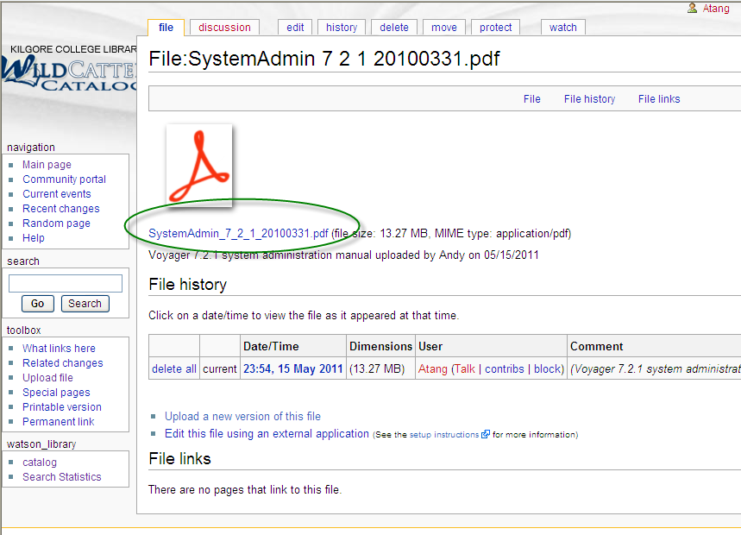
Demo – Create a new PDF link 4

Slide 15
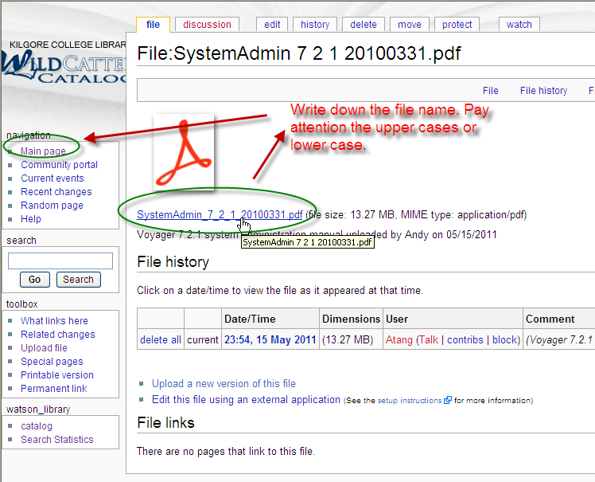
Demo – Create a new PDF link 5

Slide 16
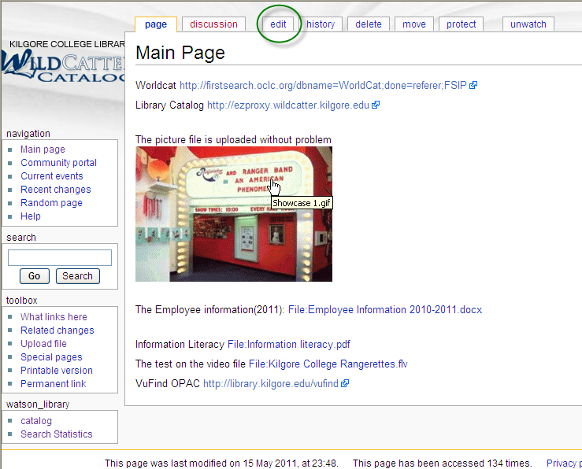
Demo – Create a new PDF link 6

Slide 17
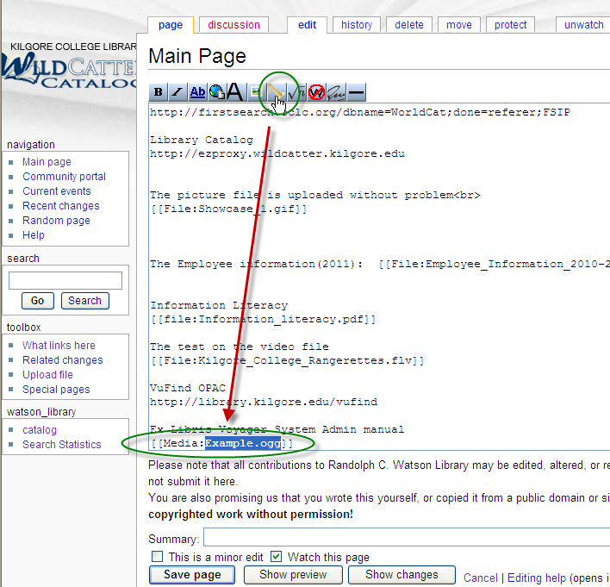
Demo – Create a new PDF link 7

Slide 18
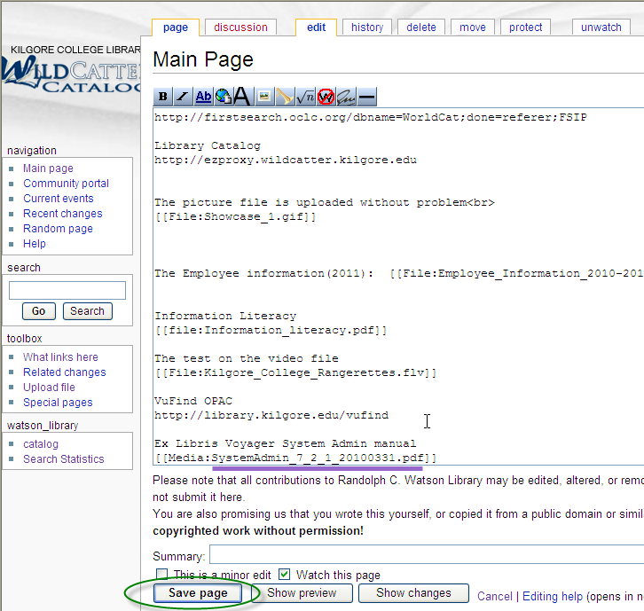
Demo – Create a new PDF link 8

Slide 19
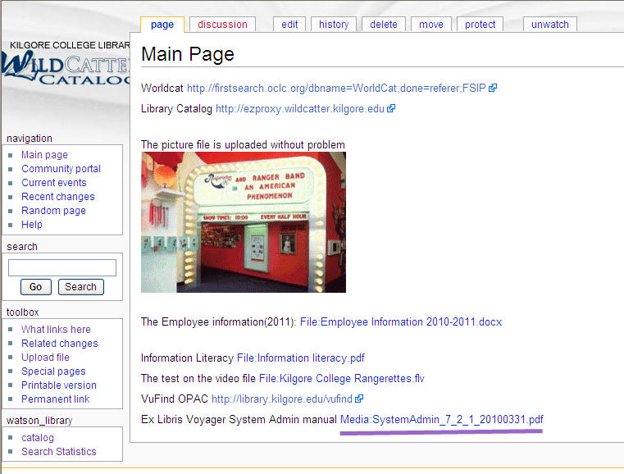
Demo – Create a new PDF link 9

Slide 20
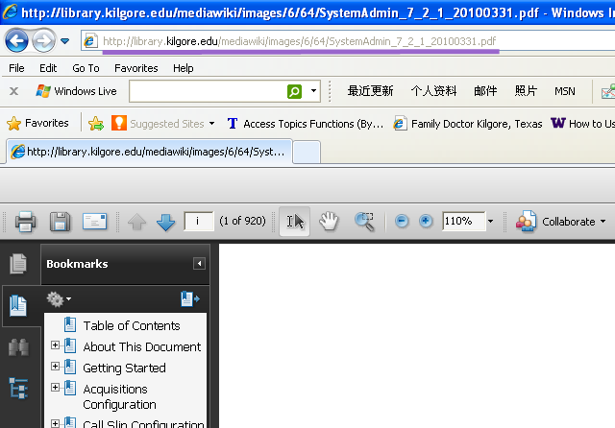
Demo – Create a new PDF link 10

Slide 21
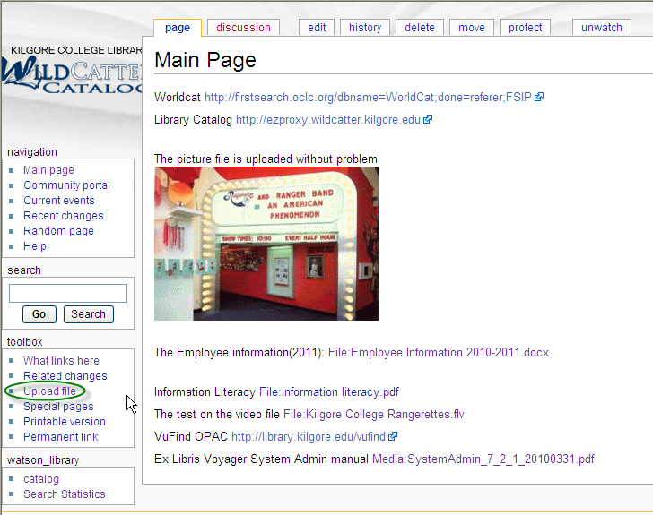
Demo – Create a Picture file display 1

Slide 22
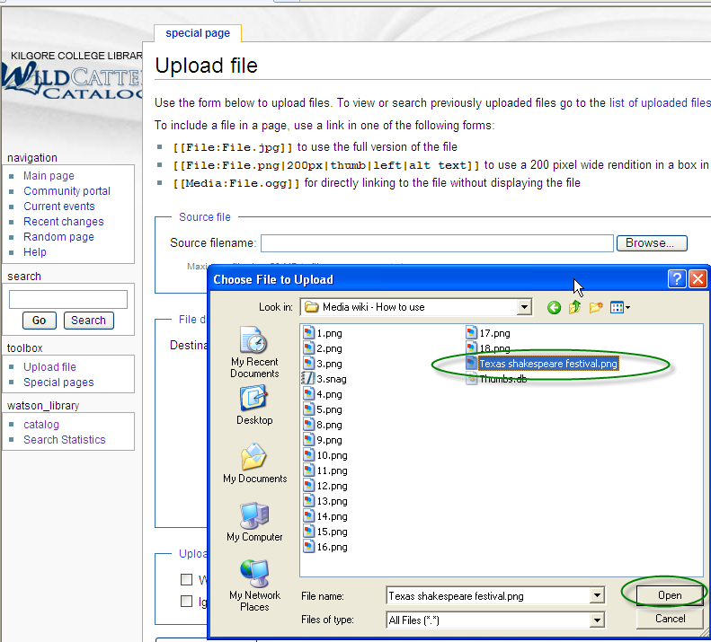
Demo – Create a Picture file display 2

Slide 23
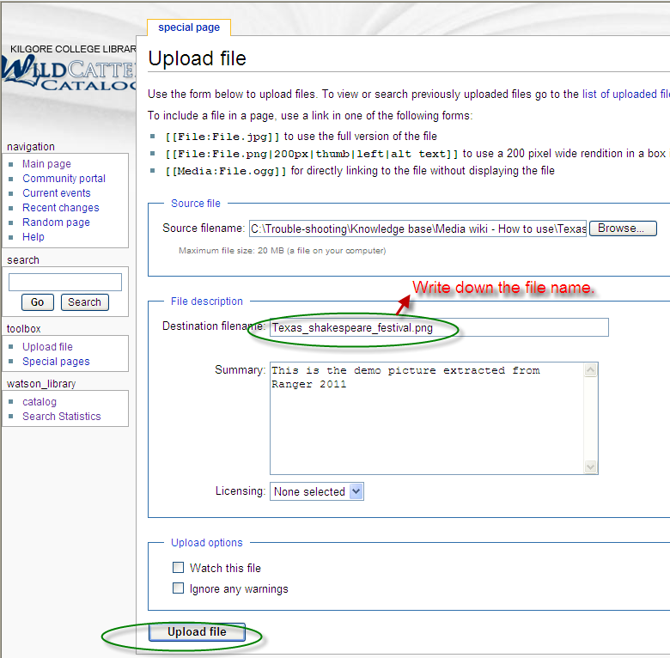
Demo – Create a Picture file display 3

Slide 24
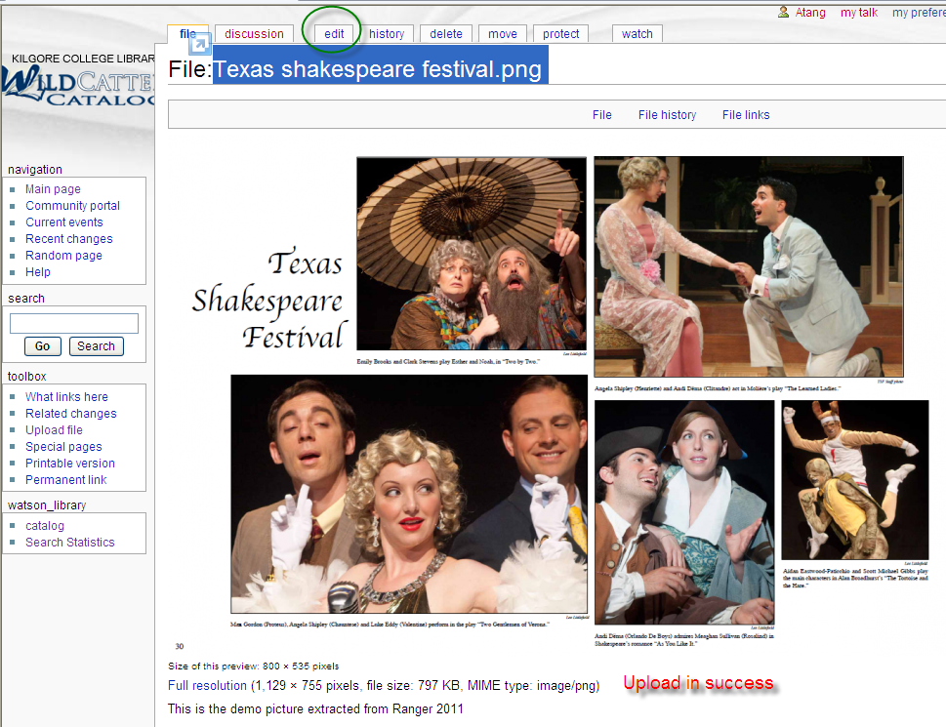
Demo – Create a Picture file display 4

Slide 25
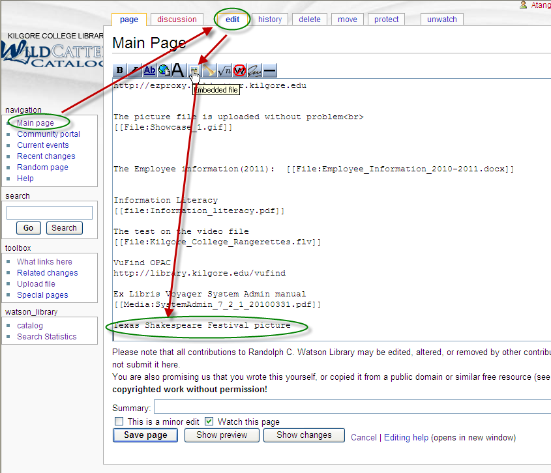
Demo – Create a Picture file display 5

Slide 26
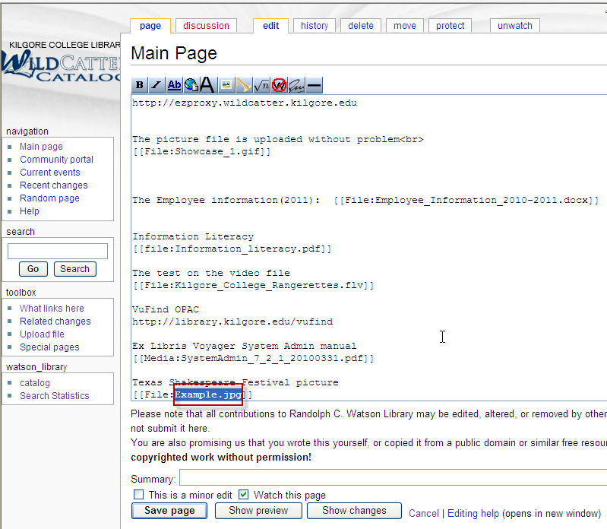
Demo – Create a Picture file display 6

Slide 27
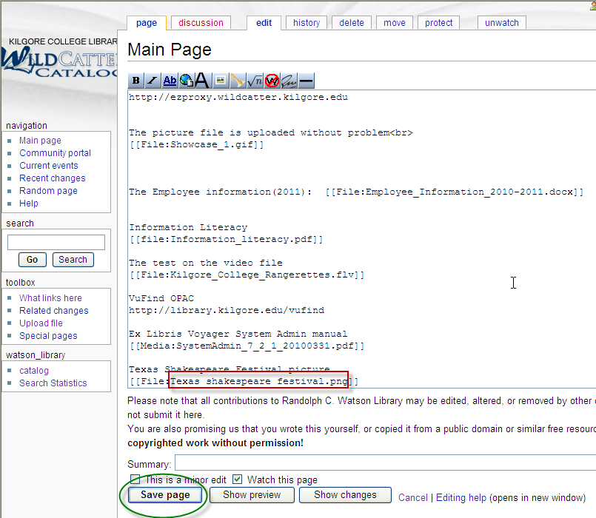
Demo – Create a Picture file display 7

Slide 28
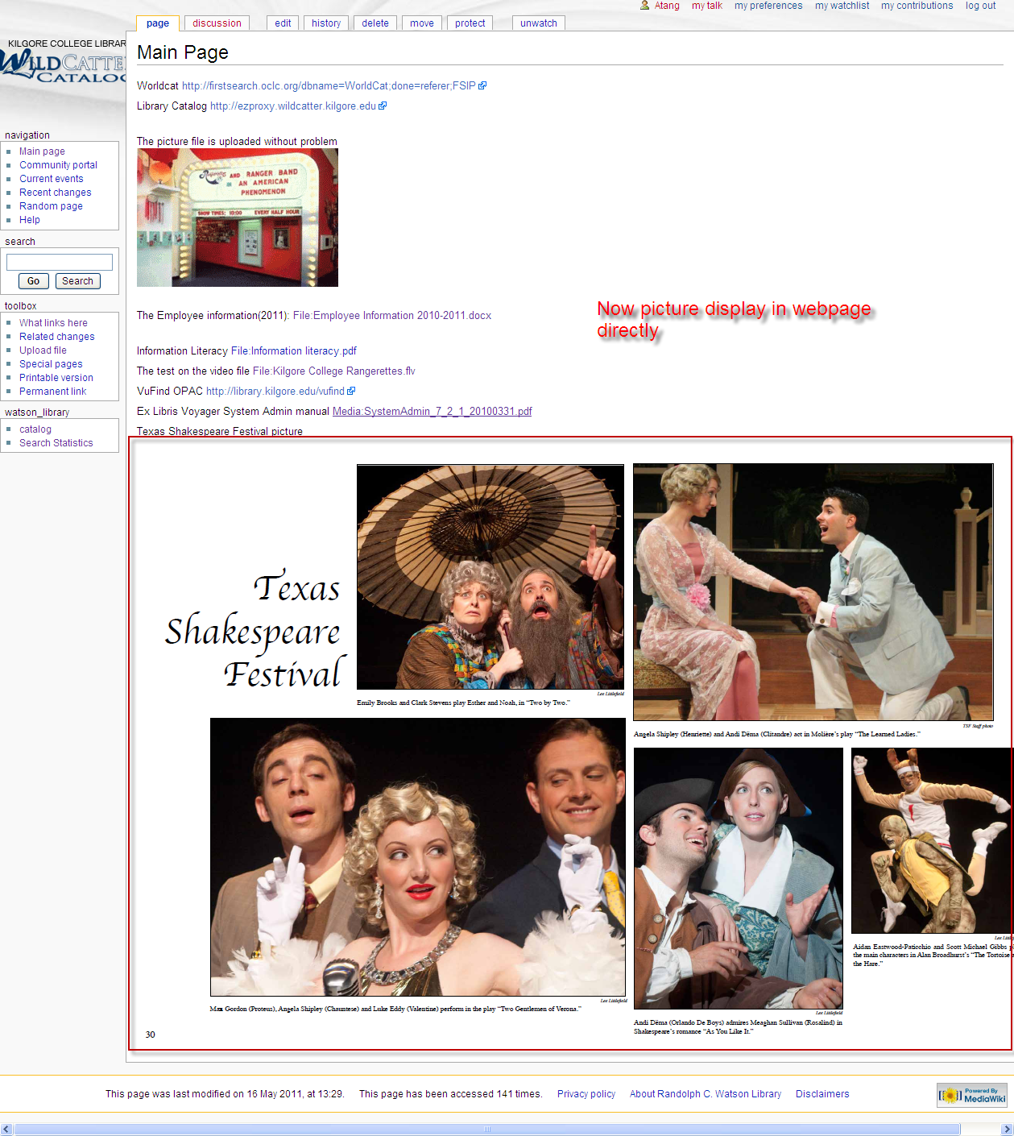
Demo – Create a Picture file display 8

Slide 29
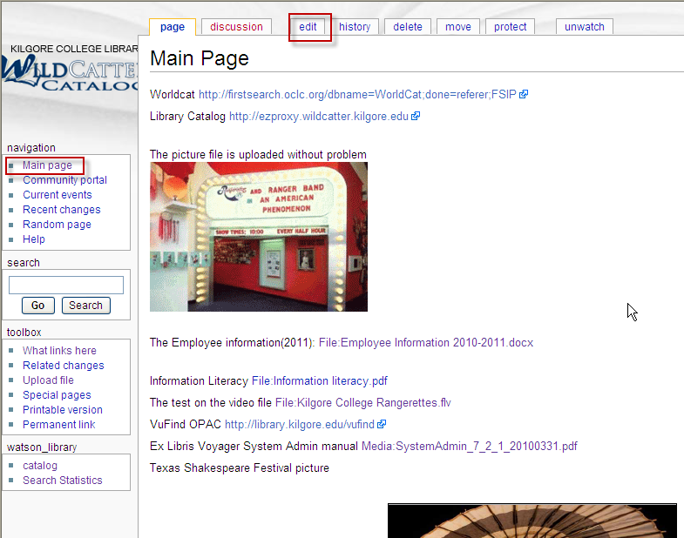
Demo – How to delete 1

Slide 30
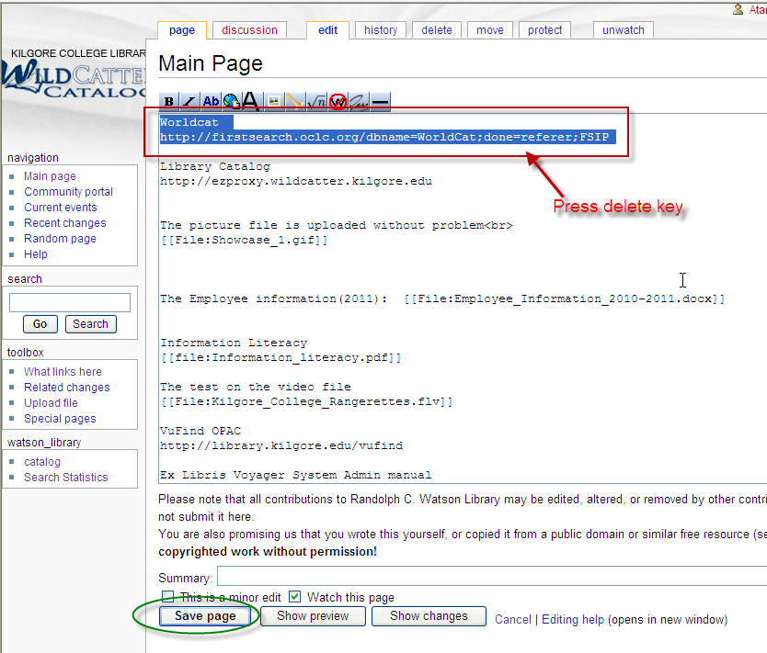
Demo – How to delete 2

Slide 31
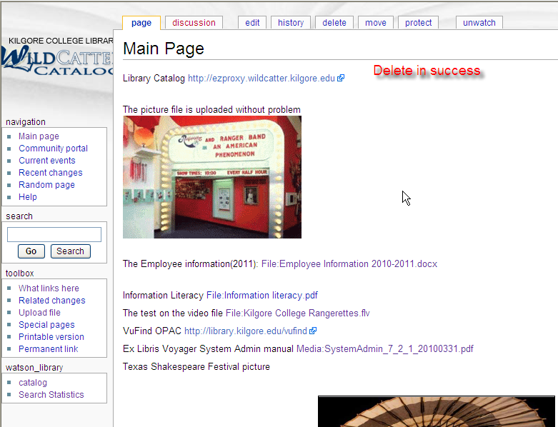
Demo – How to delete 3

Slide 32
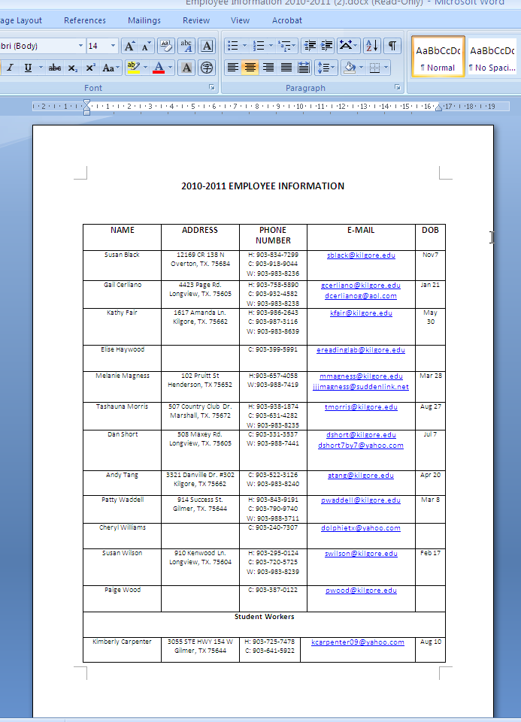
Demo – Submit Microsoft Office Doc 1

Slide 33
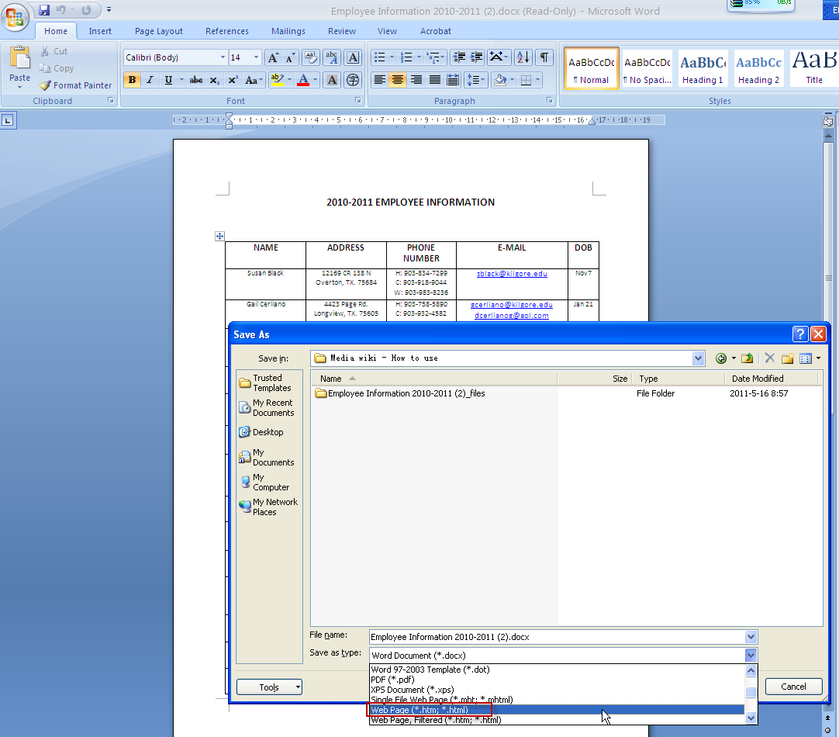
Demo – Submit Microsoft Office Doc 2

Slide 34
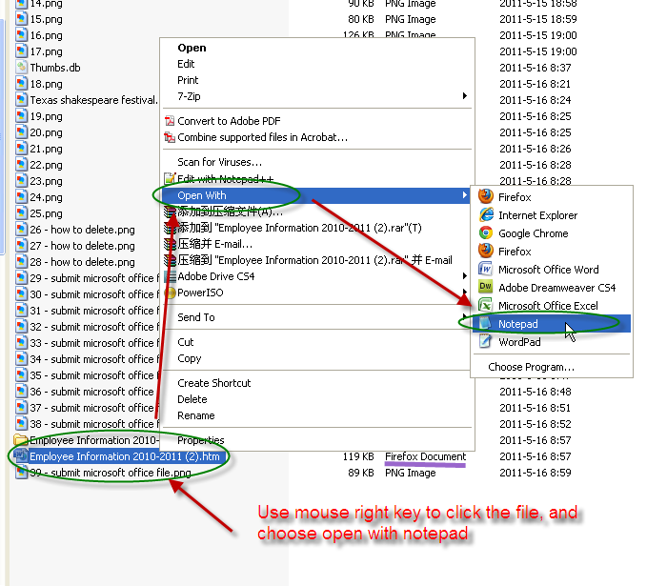
Demo – Submit Microsoft Office Doc 3

Slide 35
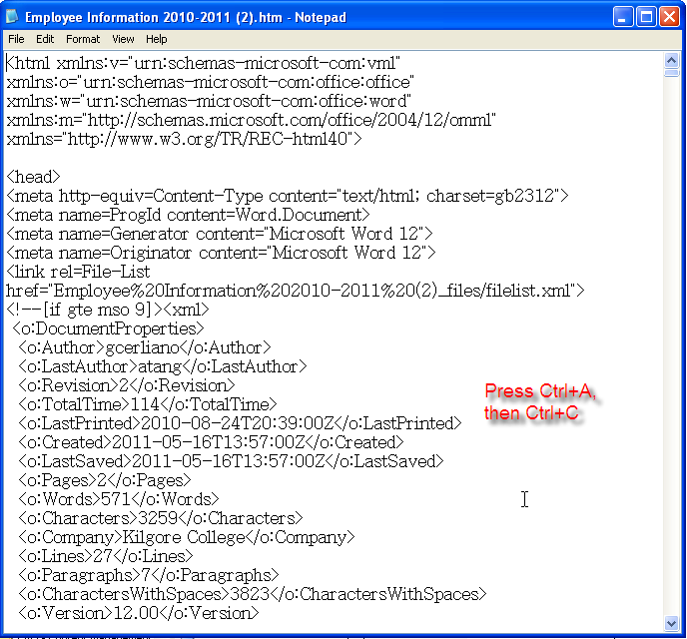
Demo – Submit Microsoft Office Doc 4

Slide 36
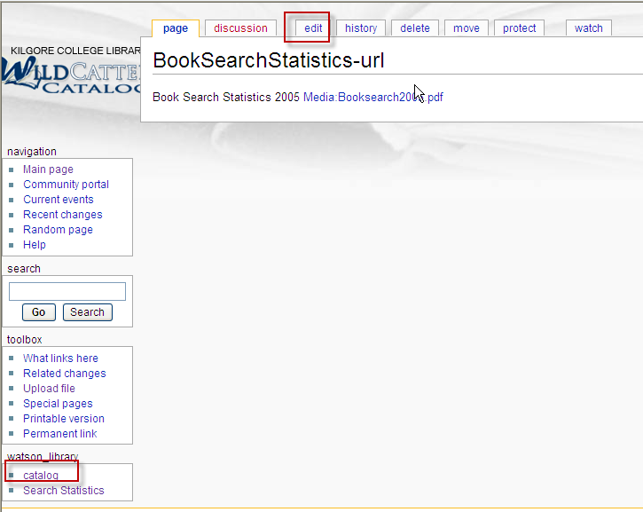
Demo – Submit Microsoft Office Doc 5

Slide 37
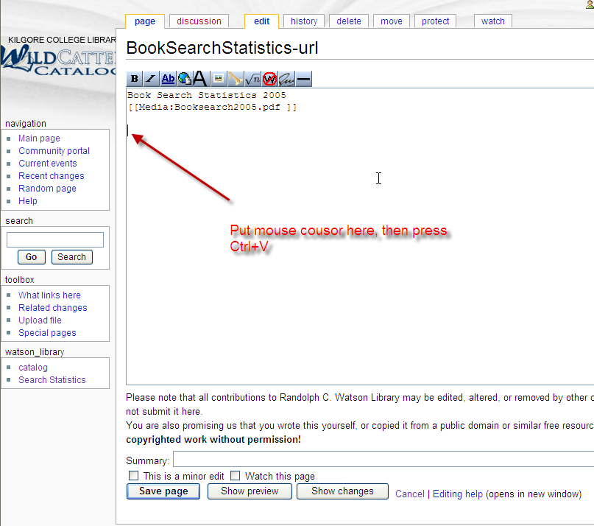
Demo – Submit Microsoft Office Doc 6

Slide 38
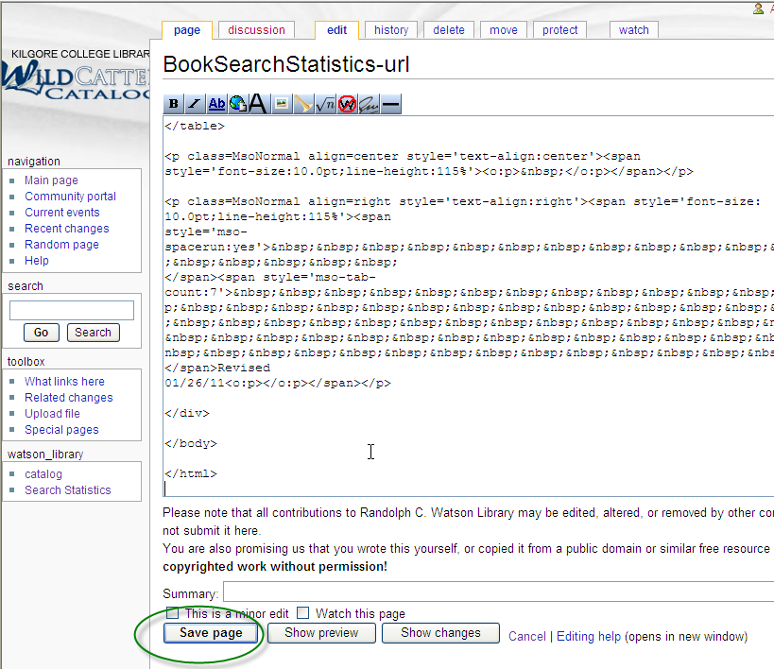
Demo – Submit Microsoft Office Doc 7

Slide 39
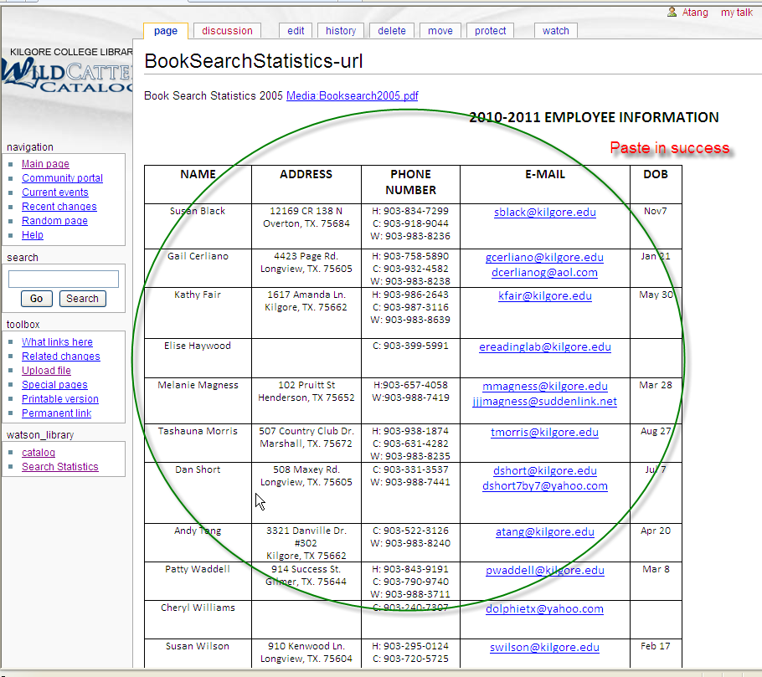
Demo – Submit Microsoft Office Doc 8

Slide 40
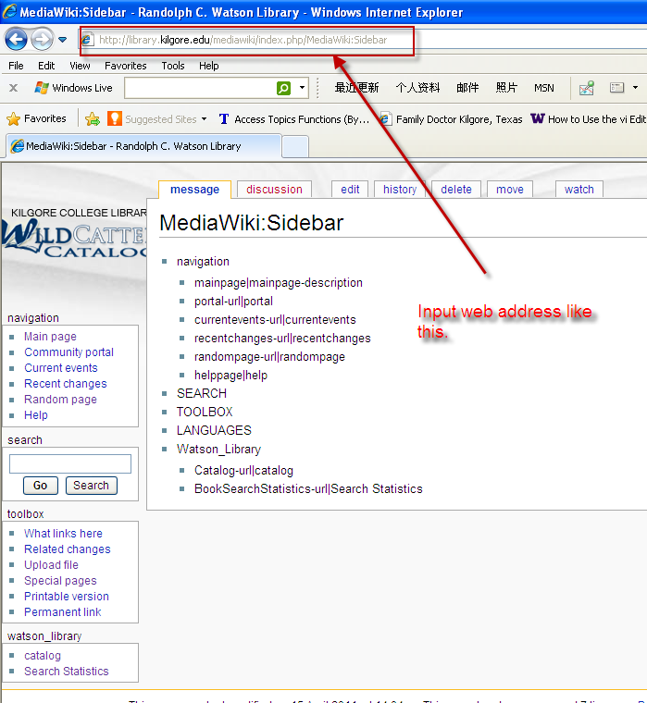
Demo – Create New Page 1

Slide 41
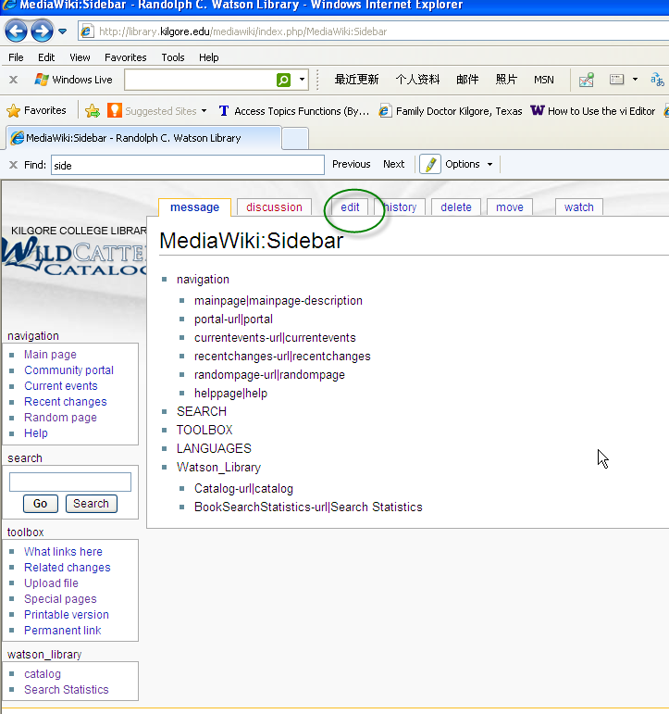
Demo – Create New Page 2

Slide 42
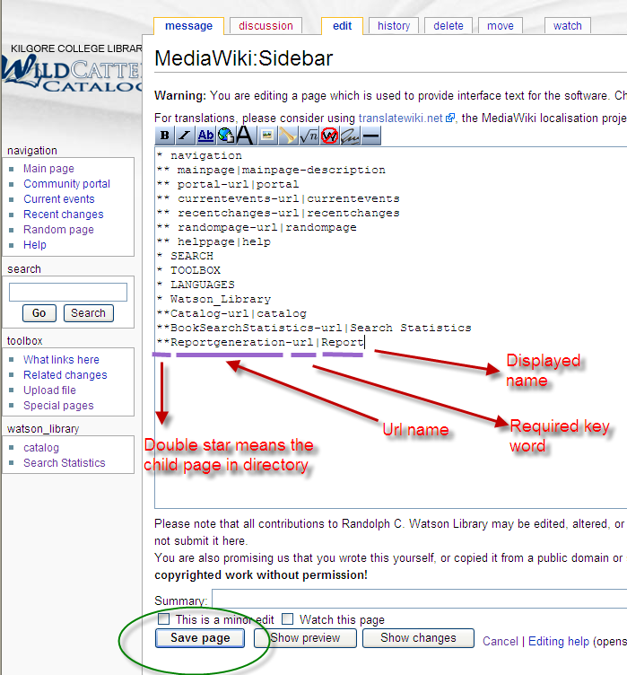
Demo – Create New Page 3

Slide 43
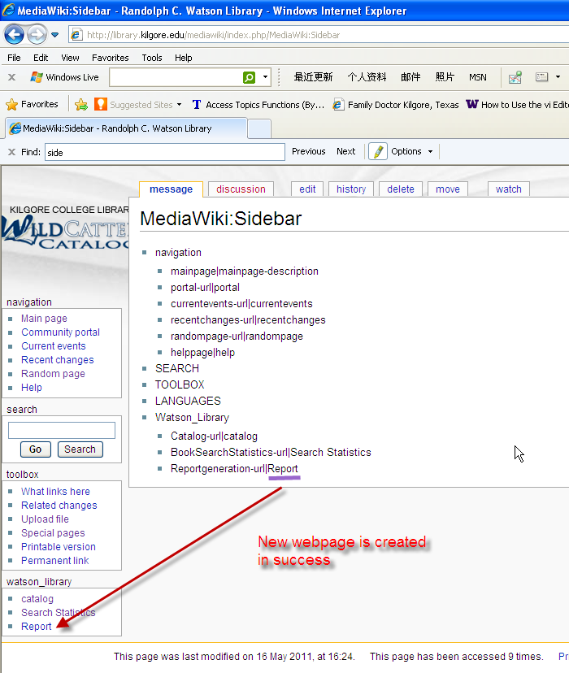
Demo – Create New Page 4

Slide 44
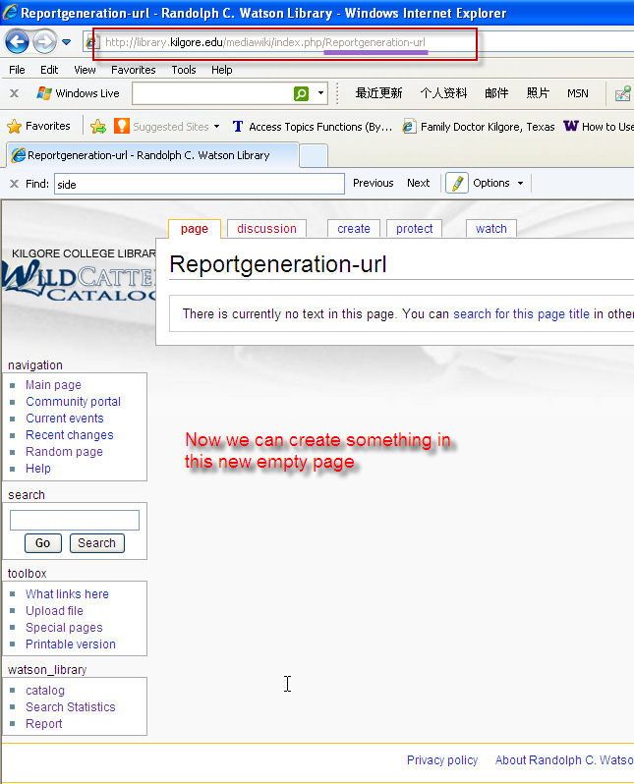
Demo – Create New Page 5

Slide 45
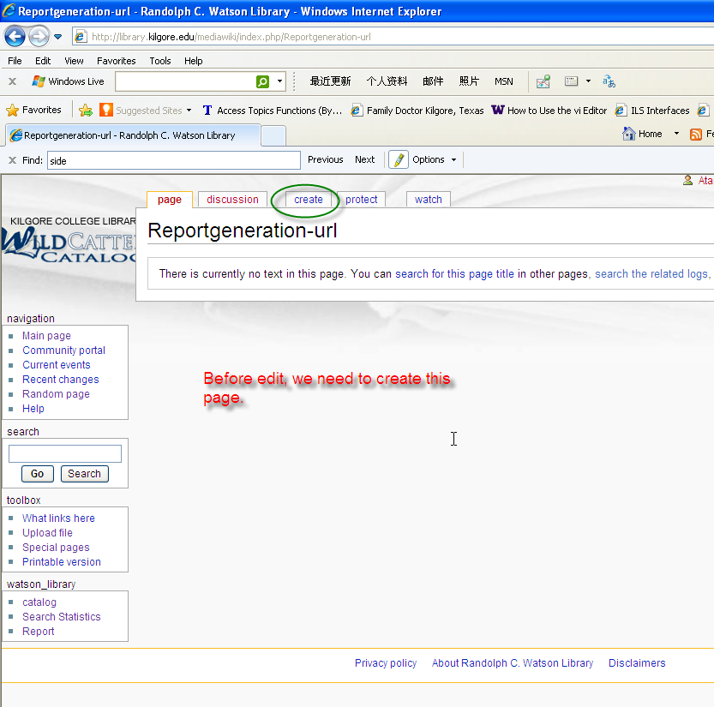
Demo – Create New Page 6

Slide 46
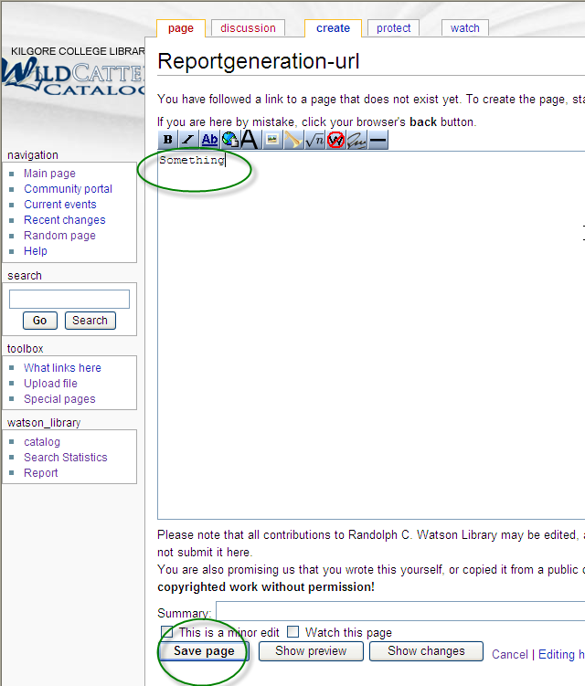
Demo – Create New Page 7

Slide 47
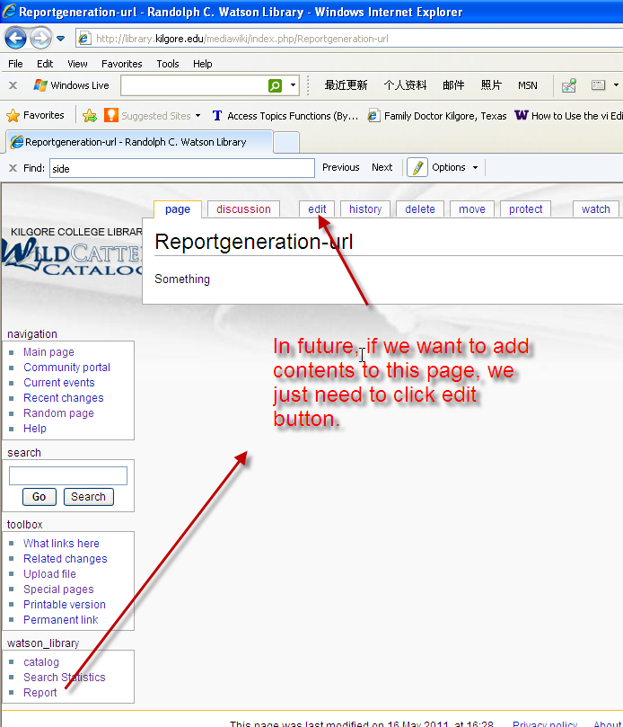
Demo – Create New Page 8

Slide 48
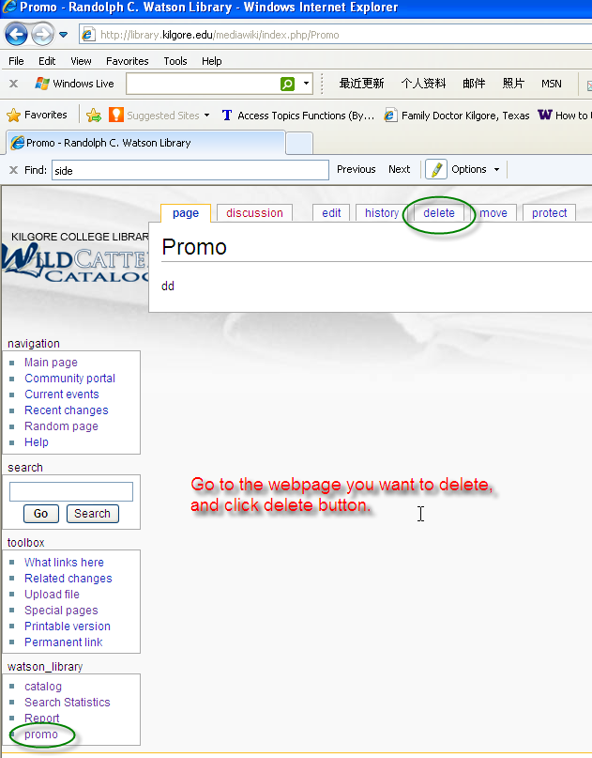
Demo – How to delete a page 1

Slide 49
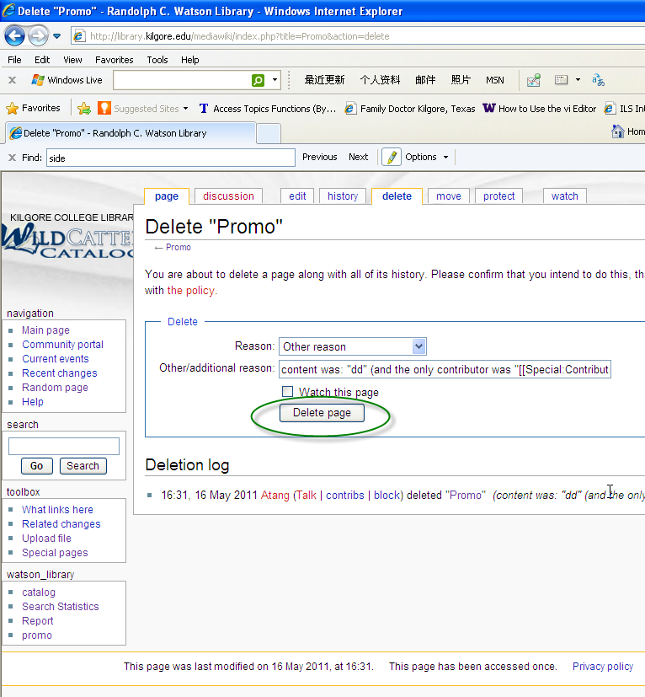
Demo – How to delete a page 2

Slide 50
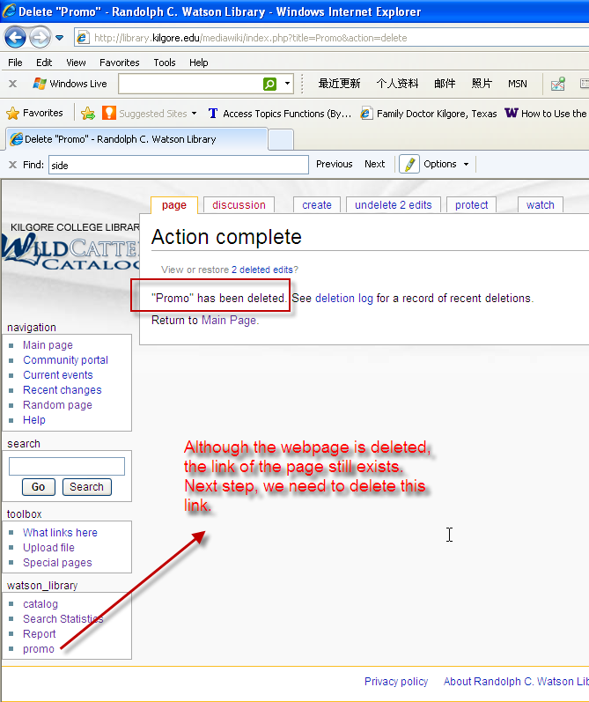
Demo – How to delete a page 3

Slide 51
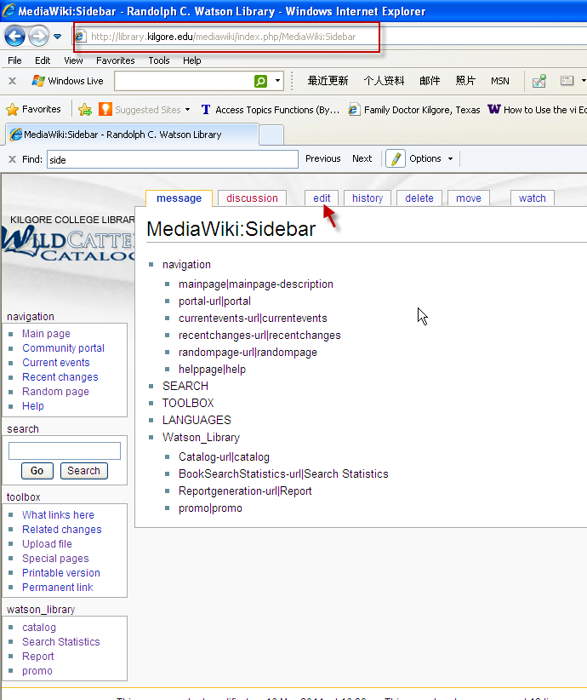
Demo – How to delete a page 4

Slide 52
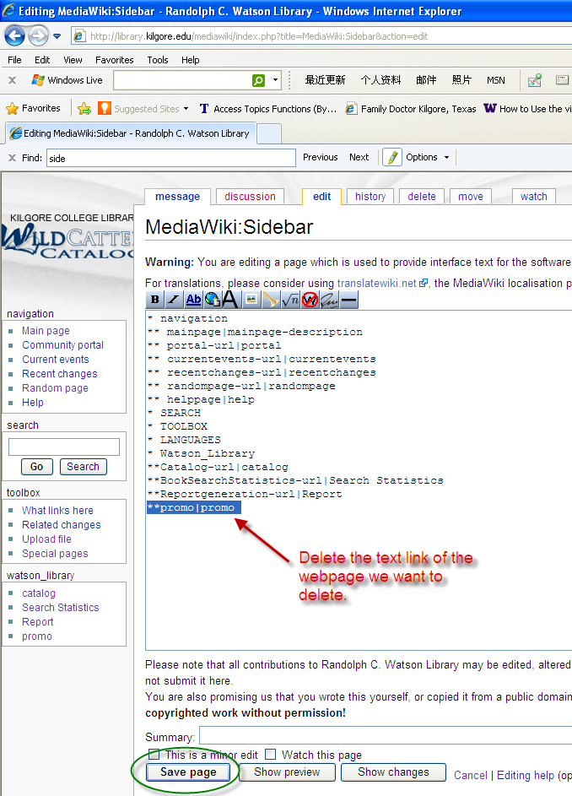
Demo – How to delete a page 5

Slide 53
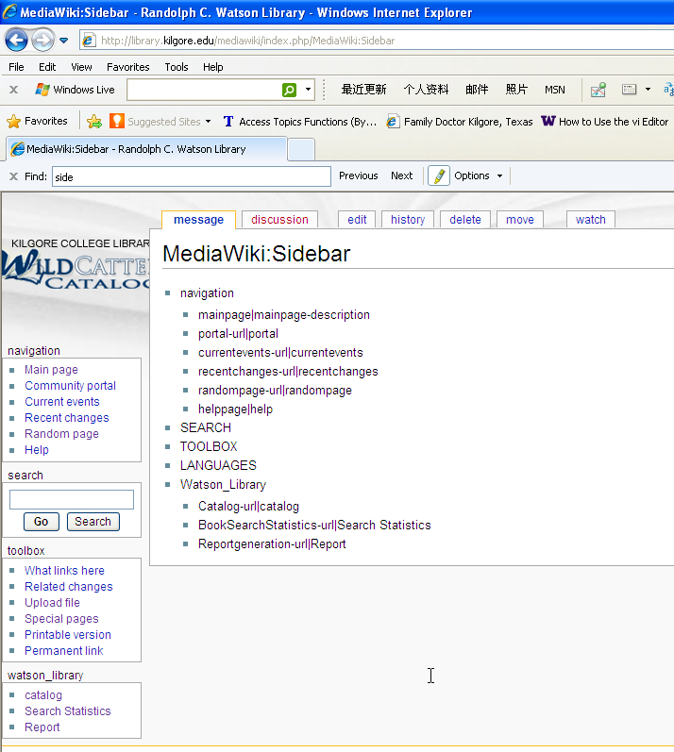
Demo – How to delete a page 6

Slide 54
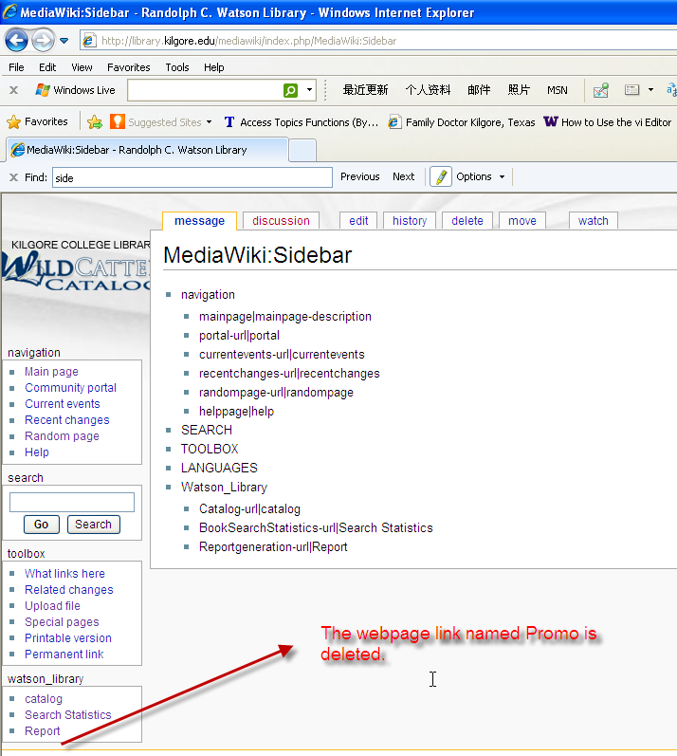
Demo – How to delete a page 7

Slide 55
The End
Thank you!

